Slide 1

DESIGN THINKING (ADS336)
UNIT-1a
Reference: Idris Mootee, Design Thinking for Strategic Innovation

Slide 2







The Team

Slide 3
Course Description
This course introduces learners to the principles and practices of Design Thinking as a human-centered approach to innovation and problem-solving.
It explores thinking processes, empathy-driven research, ideation techniques, prototyping, testing, and iterative design methods.
Students will learn to identify user needs, define real-world problems, generate creative solutions, and develop prototypes using various design tools and techniques.
Emphasis is placed on employability skills, creativity, collaboration, and human values through hands-on activities and practical applications.
By the end of the course, learners will be equipped to apply design thinking methodologies effectively in academic, professional, and social contexts.

Slide 4
Course Outcomes
CO1: Understand the design thinking process and its importance in problem- solving.
CO2: Apply empathy techniques to understand user needs and define design problems.
CO3: Generate creative ideas using ideation techniques and create basic prototypes.
CO4: Create prototypes and refine designs through iterative testing and feedback.
CO5: Use advanced design thinking tools to solve real-world problems and prototype solutions.

Slide 5
Text books:
T1: Idris Mootee, Design Thinking for Strategic Innovation, First Edition, Adams Media, 2014.
T2: David Lee, Design Thinking in the Classroom, Ulysses press, 2018.
Reference Books:
Idris Mootee, Design Thinking for Strategic Innovation, 1/e, Adams Media, 2014.
Shrrutin N Shetty, Design the Future, 1/e, Norton Press, 2018.
William lidwell, Kritinaholden, &Jill butter, Universal principles of design, 2/e, Rockport Publishers, 2010.
Chesbrough.H, The era of open innovation, 2003.

Slide 6
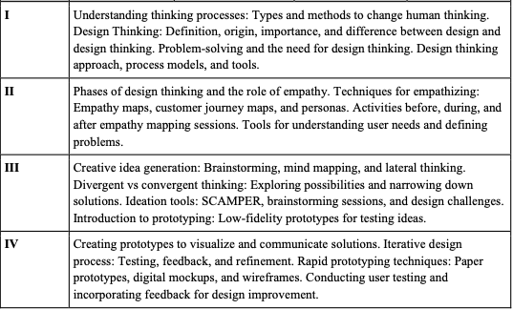
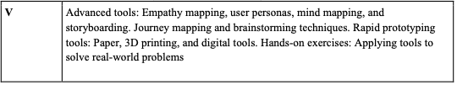
Topics

Slide 7
CIA Components
I) CIA 1
  Component 1: Seminar Presentation
  Component 2: Faculty Interview and Problem Identification
II) CIA 2 (MSE)
III) CIA 3
  Component 1: AI-Integrated Prototype/Model Development
  Component 2: Project Report and Validation

Slide 8
UNIT 1
1. Understanding thinking process :
  a. Types and methods to change human thinking.
2. Design Thinking:
  a. Definition
  b. Origin
  c. Importance
  d. Difference between design and design thinking.
3. Problem-solving and the need for design thinking.
4. Design thinking:
  a. Approach
  b. Process
  c. Models
  d. Tools.

Slide 9
Where are we?
1. Understanding thinking process :
  a. Types and methods to change human thinking.

Slide 10
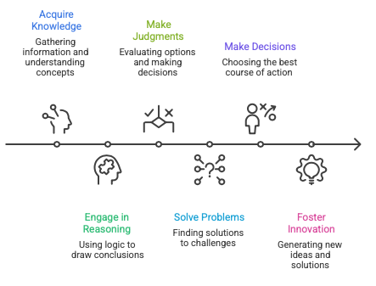
What is Thinking?
Fig: Major functions of critical thinking and cognitive processing

Slide 11
The above fig shows how people move from learning information to creating innovative solutions. It also shows how knowledge is transformed into reasoning, judgment, problem-solving, decision-making, and ultimately innovation.
Innovation is usually the outcome of a structured thinking process rather than a sudden idea.
1. Acquire Knowledge
Gathering information and understanding concepts.
What happens here?
Reading books, articles, and research papers
Attending lectures
Observing and collecting facts
Learning theories and principles
Example: 1) A student learns the fundamentals of Artificial Intelligence and Machine Learning.

Slide 12
2. Engage in Reasoning
Using logic to draw conclusions from the information acquired.
What happens here?
Analyzing evidence
Identifying patterns
Making inferences
Connecting ideas logically
Example: 1)After learning about machine learning algorithms, a student reasons which algorithm might work best for a particular dataset.

Slide 13
3. Make Judgments
Evaluating alternatives and assessing their strengths and weaknesses.
What happens here?
Comparing options
Assessing credibility
Identifying advantages and disadvantages
Critically evaluating evidence
Example: Comparing Decision Trees, Random Forests, and Neural Networks to determine which is most suitable for a project.

Slide 14
4. Solve Problems
Finding effective solutions to challenges.
What happens here?
Defining the problem
Generating possible solutions
Testing alternatives
Implementing the best solution
Example: 1) Developing a model to predict student performance using historical academic data.

Slide 15
5. Make Decisions
Choosing the most appropriate course of action.
What happens here?
Selecting among alternatives
Considering risks and benefits
Prioritizing objectives
Taking action
Example: 1) Choosing to deploy a Random Forest model because it provides the best balance of accuracy and interpretability.

Slide 16
6. Foster Innovation
Creating new ideas, methods, or solutions.
What happens here?
Thinking creatively
Combining existing knowledge in new ways
Designing novel approaches
Developing original products or services
Example: 1) Creating a new AI-based healthcare application that detects diseases from medical images.

Slide 17
Over all Flow
Acquire Knowledge
↓
Engage in Reasoning
↓
Make Judgments
↓
Solve Problems
↓
Make Decisions
↓
Foster Innovation

Slide 18
Case 2: Simple real-life example using buying a mobile phone
1. Acquire Knowledge
You gather information about different phones.
Read reviews
Check specifications
Compare prices
Example: You learn about Samsung, OnePlus, and iPhone models.
2. Engage in Reasoning
You analyze the information.
Example:
I need a good camera.
My budget is ₹30,000.
I need long battery life.
So, an expensive iPhone may not fit my budget.

Slide 19
3. Make Judgments
You evaluate the available options.
Example:
Phone A: Excellent camera, expensive
Phone B: Good camera, affordable
Phone C: Affordable, poor battery
You judge that Phone B offers the best balance
4. Solve Problems
You address your challenge.
Problem: Need a phone with good performance within ₹30,000.
Solution: Select a phone that satisfies your requirements without exceeding the budget.

Slide 20
5. Make Decisions
You choose one option.
Example: Buy Phone B.
6. Foster Innovation
You think of a new or better idea.
Example: Instead of buying immediately, you use a price-tracking app to monitor discounts and save money.

Slide 21
Case 3: Design a smart irrigation system
Acquire Knowledge → Learn about sensors, IoT, and agriculture.
Engage in Reasoning → Analyze how soil moisture affects crops.
Make Judgments → Evaluate different sensor technologies.
Solve Problems → Design a system that minimizes water wastage.
Make Decisions → Select the most cost-effective solution.
Foster Innovation → Develop an AI-enabled irrigation system that predicts watering needs automatically.

Slide 22
Analyze the major functions of critical thinking and cognitive processing
Problem: Students are frequently late to class
Acquire Knowledge: ?
Reasoning: ?
Judgment: ?
Problem Solving: ?
Decision Making: ?
Innovation: ?
Notes:
Acquire Knowledge: Record arrival times for one week.
Reasoning: Identify the main causes of lateness.
• Judgment: Evaluate possible solutions.
• Problem Solving: Design a reminder system.
• Decision Making: Implement WhatsApp reminders.
• Innovation: Create an automated attendance and reminder app.

Slide 23
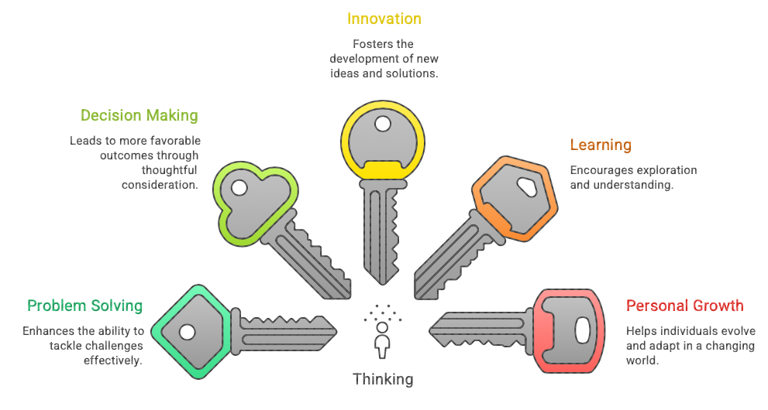
Importance of Thinking

Slide 24
The above diagram uses five keys to show that thinking is the key that unlocks learning, problem-solving, decision-making, innovation, and personal growth.
Central Idea: Thinking
Thinking is the mental process of analyzing information, making connections, evaluating options, and generating ideas. It is the foundation of many important life skills.
1. Learning
"Encourages exploration and understanding."
Thinking helps us:
  Understand new concepts
  Ask questions
  Connect new knowledge with existing knowledge
Example: When learning AI, students think about how algorithms work rather than just memorizing definitions.

Slide 25
2. Problem Solving
"Enhances the ability to tackle challenges effectively."
Thinking helps us:
  Identify problems
  Analyze causes
  Find suitable solutions
Example: If a computer is not connecting to Wi-Fi, thinking helps identify whether the issue is with the router, password, or network settings.
3. Decision Making
"Leads to more favourable outcomes through thoughtful consideration."
Thinking helps us:
  Compare alternatives
  Weigh advantages and disadvantages
  Select the best option
Example: Choosing between higher studies and a job offer after evaluating career goals, costs, and opportunities.

Slide 26
4. Innovation
"Fosters the development of new ideas and solutions."
Thinking helps us:
  Generate creative ideas
  Improve existing systems
  Develop new products and technologies
Example: Creating a smart attendance system using facial recognition instead of manual attendance.
5. Personal Growth
"Helps individuals evolve and adapt in a changing world."
Thinking helps us:
  Learn from mistakes
  Improve skills
  Adapt to new situations
Example: After receiving feedback on a presentation, a student reflects on weaknesses and improves communication skills.

Slide 27
Classroom Example
Imagine a student preparing for an exam:
Learning → Studies the subject.
Problem Solving → Finds ways to understand difficult topics.
Decision Making → Chooses a study schedule.
Innovation → Creates mind maps or flashcards for revision.
Personal Growth → Becomes more disciplined and confident.
All of these are possible because the student thinks.

Slide 28
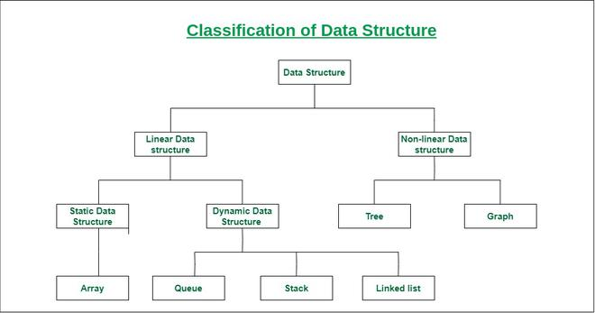
Mind Maps
A mind map is a visual diagram that organizes information around a central topic. It uses branches to connect related ideas, making it easier to understand relationships between concepts.
Flash Card: A flashcard is a study card with a question, term, or concept on one side and the answer or explanation on the other side.

Slide 29
Thinking is like a master key. It unlocks:
  Better learning
  Effective problem-solving
  Wise decision-making
  Creativity and innovation
  Continuous personal growth
Without thinking, knowledge remains information; with thinking, knowledge becomes understanding, action, and progress.

Slide 30
How Humans Think
Observation
Interpretation
Analysis
Evaluation
Decision Making
Activity:
The Stroop Effect (System 1 vs. System 2)
This activity perfectly demonstrates the conflict between fast, automatic thinking and slow, deliberate reasoning.
The Setup: Write a list of color words on the board, but print them in different colored ink (e.g., write the word "BLUE" using red marker).
The Task: Have students pair up. One student must go down the list and say the ink color out loud as fast as possible, while their partner times them.
The Takeaway: Students will struggle and slow down because System 1 automatically reads the word, forcing System 2 to step in, override the error, and name the color instead.

Slide 31
How humans think (continuation…)
These stages describe a common process of human thinking, where information is received, understood, examined, judged, and then used to make choices.
1. Observation
Observation is the process of gathering information through our senses (seeing, hearing, reading, touching, etc.).
Example:
A student notices that several classmates are absent from class.
Key Question:
What is happening?
2. Interpretation
Interpretation involves assigning meaning to what has been observed.
Example:
The student learns that many classmates are absent because they are preparing for an upcoming placement test.
Key Question:
What does this information mean?

Slide 32
3. Analysis
Analysis is the process of breaking information into parts and examining relationships, causes, and patterns.
Example:
The student analyzes:
  When is the placement test?
  How important is it?
  How much preparation is required?
  What topics are being covered?
Key Question:
Why is this happening, and what factors are involved?
4. Evaluation
Evaluation means judging the information, evidence, or alternatives based on specific criteria.
Example:
The student evaluates:
  Is placement preparation more important than today's class?
  What are the advantages and disadvantages of skipping class?
Key Question:
Which option is better or more valuable?

Slide 33
5. Decision Making
Decision making is selecting a course of action based on the evaluation.
Example:
The student decides to attend the class and spend extra time preparing for the placement test later.
Key Question:
What should I do?
Example: Buying a Laptop
Stage | Example
Observation | You see three laptops with different prices and specifications.
Interpretation | You understand that higher specifications usually mean better performance.
Analysis | You compare RAM, processor, storage, battery life, and cost.
Evaluation | You determine which laptop offers the best value for your needs and budget.
Decision Making | You purchase the selected laptop.

Slide 34
Flow of Thinking
Observation
↓
Interpretation
↓
Analysis
↓
Evaluation
↓
Decision Making
This process forms the basis of critical thinking, helping people make informed and rational decisions rather than acting only on impulse.

Slide 35
Activity: Stroop Effect
The Stroop Effect is a classic psychology experiment that demonstrates how two different cognitive processes compete with each other:
  System 1 Thinking: Fast, automatic, intuitive, and effortless.
  System 2 Thinking: Slow, deliberate, analytical, and effortful.
How the Activity Works
Suppose you write:
  BLUE (in red ink)
  GREEN (in blue ink)
  YELLOW (in green ink)
Students must say the ink color, not read the word.
For example:
If the word "BLUE" is written in red ink, the correct answer is "Red."
Notes:
Cognitive processes are the mental activities involved in acquiring, processing, storing, and using information. They allow us to perceive the world, think, learn, remember, solve problems, and make decisions.

Slide 36
Why It Is Difficult ?
System 1: Reading words is an automatic process for most people. When students see the word "BLUE," their brain immediately wants to say "Blue“.
System 2: The task requires them to ignore the word and identify the ink color. This requires conscious attention and self-control
Result:
  Students hesitate.
  They make more mistakes.
  Their response time increases.
Learning Outcome
The activity demonstrates:
  How automatic thinking can interfere with decision-making.
  The difference between instinctive and deliberate reasoning.
  The mental effort required to override habitual responses.
  Why humans sometimes make errors even when the correct answer is obvious.

Slide 37



Thinking and Innovation
Ideas emerge from thinking
Better thinking → better solutions
Essential for organizations
Notes:
UPI (Unified Payments Interface) was developed by the National Payments Corporation of India, an organization established by the Reserve Bank of India and the Indian Banks' Association. UPI was officially launched in April 2016 by then RBI Governor Raghuram Rajan. Nandan Nilekani – played an important advisory role and helped shape the vision for a simple digital payments ecosystem.
ONDC (Open Network for Digital Commerce) is an initiative by the Government of India that aims to create an open, interoperable network for digital commerce, similar to how UPI created an open network for digital payments. Open Network for Digital Commerce was launched by the Department for Promotion of Industry and Internal Trade under the Ministry of Commerce and Industry.
Aadhaar: Unique Identification Authority of India issues Aadhaar, a 12-digit unique identification number provided to residents of India.

Slide 38
Characteristics of Effective Thinkers
Curious, Open-minded, Analytical, Creative and Reflective

Slide 39
Effective thinkers approach problems and decisions thoughtfully. They possess several important qualities that help them understand situations, solve problems, and make better decisions.
1. Curious
Curious people have a strong desire to learn and understand new things. They ask questions and seek information beyond what is immediately available.
Characteristics:
  Ask "Why?", "How?", and "What if?"
  Eager to learn new concepts
  Explore different viewpoints
Example: A student learning Artificial Intelligence asks how machine learning algorithms actually learn from data instead of simply memorizing definitions.
Benefit: Curiosity leads to continuous learning and discovery.

Slide 40
2. Open-Minded
Open-minded thinkers are willing to consider different ideas, perspectives, and evidence, even when those ideas differ from their own beliefs.
Characteristics:
  Listen to others respectfully
  Accept constructive criticism
  Willing to change opinions when presented with strong evidence
Example: During a group discussion, a student considers a teammate's solution even though it differs from their own approach.
Benefit: Helps avoid bias and improves decision-making.

Slide 41
3. Analytical
Analytical thinkers examine information carefully, identify patterns, and break complex problems into smaller parts.
Characteristics:
  Compare alternatives
  Identify causes and effects
  Use logic and evidence
Example: Before selecting an algorithm, a programmer compares time complexity, memory usage, and scalability.
Benefit: Analytical thinking leads to accurate conclusions and effective problem solving.

Slide 42
4. Creative
Creative thinkers generate original ideas and find innovative solutions to problems.
Characteristics:
  Think beyond conventional methods
  Explore multiple solutions
  Combine ideas in new ways
Examples:
1)Problem: Students often forget to switch their phones to silent mode before entering a classroom.
Creative Solution:
A student develops a mobile app that automatically switches the phone to silent mode when it detects the user has entered a college campus or classroom area using GPS or Wi-Fi.
2) Problem: People often lose their TV remote.
Creative Solution:
A person attaches a Bluetooth tracker to the remote and uses a mobile app to make the remote ring whenever it is misplaced.
Benefit:
Creativity encourages innovation and adaptability.

Slide 43
5. Reflective
Reflective thinkers review their experiences, decisions, and actions to learn and improve.
Characteristics:
  Evaluate past performance
  Learn from mistakes
  Seek continuous improvement
Example:
After an exam, a student analyzes which study methods worked well and which need improvement.
Benefit:
Reflection promotes personal growth and better future decisions.

Slide 44
Characteristic | Meaning | Example
Curious | Seeks knowledge and asks questions | Exploring how AI models learn
Open-Minded | Considers different viewpoints | Listening to alternative solutions
Analytical | Uses logic and evidence | Comparing algorithms before selection
Creative | Generates new ideas and solutions | Designing an innovative app feature
Reflective | Learns from experience | Reviewing exam preparation strategies
An effective thinker combines all five qualities: they ask questions (curious), consider different perspectives (open-minded), examine evidence (analytical), generate ideas (creative), and learn from experience (reflective)

Slide 45
Effective Thinker Model
Curious
↓
Open-Minded
↓
Analytical
↓
Creative
↓
Reflective
↓
Better Understanding and Decisions

Slide 46
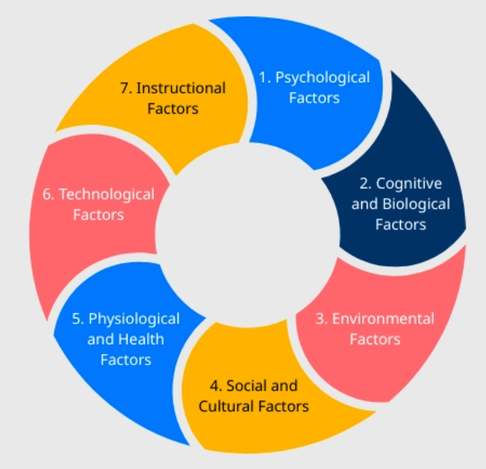
Factors Affecting Thinking

Slide 47
The image shows seven major factors that affect thinking. Thinking is the mental process of understanding, analyzing, reasoning, solving problems, and making decisions. Each factor can influence how effectively a person thinks.
Thinking is influenced by a combination of psychological, cognitive and biological, environmental, social and cultural, physiological and health, technological, and instructional factors. These factors interact with one another to shape how individuals learn, reason, solve problems, and make decisions.
1. Psychological Factors
These relate to a person's emotions, attitudes, motivation, and personality.
Examples:
Stress and anxiety can reduce concentration.
Confidence can improve decision-making.
Motivation encourages deeper thinking.
Effect: Positive emotions improve thinking, while negative emotions may harm judgment.

Slide 48
2. Cognitive and Biological Factors
These involve mental abilities and biological characteristics.
Examples:
Intelligence and memory capacity.
Attention span and perception.
Brain development and genetic influences.
Effect: Strong cognitive abilities help individuals process information, reason logically, and solve problems efficiently.
3. Environmental Factors
The surroundings in which a person lives, studies, or works influence thinking.
Examples:
Noise and distractions.
Availability of learning resources.
Family and community environment.
Effect: A supportive and stimulating environment promotes better thinking and creativity.
Notes:
Cognitive refers to the mental processes involved in acquiring, understanding, storing, and using knowledge and information.

Slide 49
4. Social and Cultural Factors
Society and culture shape beliefs, values, and ways of reasoning.
Examples:
Family traditions.
Social norms and expectations.
Cultural beliefs and practices.
Effect: They influence how people interpret information and make decisions.
5. Physiological and Health Factors
Physical health affects mental performance.
Examples:
Adequate sleep.
Proper nutrition.
Exercise and overall fitness.
Illness or fatigue.
Effect: Good health improves concentration and memory, while poor health can hinder thinking.

Slide 50
6. Technological Factors
Technology affects how people access and process information.
Examples:
Internet and digital resources.
Educational software.
Social media and smartphones.
Effect: Technology can enhance learning and problem-solving, but excessive use may reduce attention and critical thinking.
7. Instructional Factors
Teaching methods and educational experiences influence thinking skills.
Examples:
Quality of instruction.
Classroom activities.
Problem-based learning.
Feedback from teachers.
Effect: Effective teaching encourages critical thinking, creativity, and logical reasoning.

Slide 51
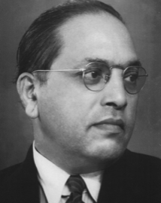

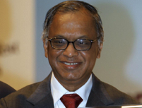
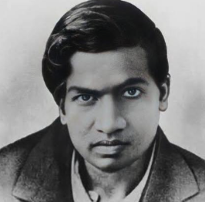
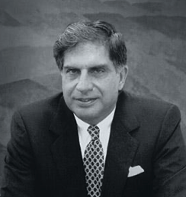

Types of Thinking – Overview
Critical Thinker : Dr B. R. Ambedkar
Creative Thinker : A. R. Rahman
Analytical Thinker : N. R. Narayana Murthy
Lateral Thinker : Verghese Kurien (Father of white revolution (milk))
Logical Thinker : Srinivasa Ramanujan
Strategic Thinker : Ratan Tata

Slide 52
a) Critical Thinking
Example
Objective evaluation
Fact-based reasoning
Evidence analysis
Avoid assumptions
Choosing a smartphone
Compare features
Analyze reviews
Evaluate costs

Slide 53
1. Objective Evaluation
Looking at a situation fairly and without personal bias or emotions.
Considering all sides before reaching a conclusion.
Example: A teacher grades students based on their performance, not personal likes or dislikes.
2. Fact-Based Reasoning
Making judgments based on facts, data, and reliable information rather than opinions or rumors.
Using evidence to support conclusions.
Example: A doctor diagnoses a disease based on test results, not guesses.
3. Evidence Analysis
Examining and evaluating available evidence carefully.
Checking whether the evidence is accurate, relevant, and sufficient.
Example: A researcher reviews experimental data before accepting a scientific claim.

Slide 54
4. Avoid Assumptions
Not jumping to conclusions without proof.
Questioning beliefs and seeking evidence before accepting something as true.
Example: If a student is absent, do not assume they are lazy; there may be a valid reason such as illness.
These four elements help develop critical thinking:
Objective evaluation → Be unbiased.
Fact-based reasoning → Use facts and data.
Evidence analysis → Examine proof carefully.
Avoid assumptions → Do not conclude without evidence.
All these together enable people to make logical, informed, and reliable decisions.

Slide 55
b) Creative Thinking
Example
Generating new ideas
Exploring possibilities
Innovation-focused
Imaginative
Reduce plastic waste
Reusable packaging
Smart recycling bins
Eco-friendly materials

Slide 56
Creative thinking is the ability to generate original ideas, explore different possibilities, and find innovative solutions to problems. It involves looking beyond conventional approaches and using imagination to create something new or improve existing ideas.
1. Generating New Ideas
Creative thinkers produce fresh and unique ideas rather than relying only on established methods.
Example:
A teacher uses gamification and interactive quizzes instead of traditional lectures to make learning more engaging.
2. Exploring Possibilities
Creative thinking involves considering multiple alternatives and perspectives before making a decision.
Example:
When designing a smart city solution, an engineer explores various technologies such as IoT sensors, AI-based traffic management, and renewable energy systems before selecting the best approach.

Slide 57
3. Innovation-Focused
Creative thinkers aim to develop new products, services, or processes that add value and solve problems effectively.
Example:
The development of digital payment systems such as Unified Payments Interface (UPI) revolutionized financial transactions by enabling instant money transfers through mobile devices.
4. Imaginative
Imagination helps individuals visualize possibilities that do not yet exist and transform them into reality.
Example:
A software developer imagines a virtual reality classroom where students can conduct science experiments safely in a simulated environment and then develops the application.

Slide 58
Characteristics of Creative Thinkers
  Curious and willing to learn
  Open to new experiences and perspectives
  Flexible in their thinking
  Willing to take calculated risks
  Able to connect unrelated ideas
  Innovative and solution-oriented
Example
A college student notices that classmates often miss assignment deadlines. Instead of merely reminding them, the student designs a mobile app that sends personalized reminders, tracks progress, and rewards timely submissions. This demonstrates generating new ideas, exploring possibilities, focusing on innovation, and using imagination to solve a practical problem.

Slide 59
c) Analytical Thinking
Example
Breaking problems into parts
Understanding relationships
Finding root causes
Attendance
Study hours
Assessment scores
Improvement areas

Slide 60
Analytical thinking is the ability to examine information systematically, break complex problems into smaller parts, identify relationships among components, and determine the underlying causes of issues. It helps individuals make logical and informed decisions.
1. Breaking Problems into Parts
Analytical thinkers divide a complex problem into smaller, manageable components to understand it better and solve it effectively.
Example: A university notices a decline in student performance. Instead of treating it as a single issue, the academic team analyzes attendance records, teaching methods, assessment patterns, study habits, and student feedback separately.
2. Understanding Relationships
Analytical thinking involves identifying how different factors influence one another and recognizing patterns or connections.
Example: A data analyst studying online shopping behavior discovers that customers who receive personalized product recommendations are more likely to make purchases. Understanding this relationship helps improve marketing strategies.

Slide 61
3. Finding Root Causes
Rather than addressing symptoms, analytical thinkers investigate the fundamental reason behind a problem.
Example: A manufacturing company experiences frequent machine breakdowns. Instead of repeatedly repairing the machines, the maintenance team analyzes operational data and discovers that inadequate lubrication schedules are the root cause. Correcting the maintenance process prevents future failures.
Characteristics of Analytical Thinkers
Logical and systematic
Detail-oriented
Evidence-based decision makers
Good at identifying patterns and trends
Strong problem-solving abilities
Objective and fact-focused

Slide 62
Example: A software company receives a large number of customer complaints about its mobile application.
An analytical thinker would:
  Break the problem into parts (app performance, user interface, login process, network issues, and customer feedback).
  Analyze the relationships between user complaints and app usage data.
  Identify the root cause (for example, the app crashes frequently after a recent software update).
  Implement a solution by fixing the bugs and thoroughly testing the updated version before release.
Result:
The number of app crashes decreases, customer complaints reduce significantly, user satisfaction improves, and app ratings increase.

Slide 63
d) Logical Thinking
Example
Sequential reasoning
Cause-and-effect analysis
Structured conclusions
Make a plan to learn a topic

Slide 64
Logical thinking is the process of using reason, facts, and systematic steps to analyze information and arrive at valid conclusions. It helps individuals make decisions based on evidence rather than assumptions or emotions.
1. Sequential Reasoning
Sequential reasoning involves following a series of logical steps in the correct order to solve a problem or reach a conclusion.
Example:
A student follows these steps to solve a programming problem:
  Understand the problem statement.
  Design an algorithm.
  Write the code.
  Test the program.
  Debug errors if necessary.
Each step logically follows the previous one.

Slide 65
2. Cause-and-Effect Analysis
Logical thinkers identify how one event or action leads to another.
Example:
A company notices lower website traffic.
  Cause: Reduced social media marketing activities.
  Effect: Fewer visitors reach the website.
  Conclusion: Increasing marketing efforts may improve website traffic.
3. Structured Conclusions
Logical thinking helps draw conclusions that are supported by facts and evidence.
Example: A teacher observes that students who attend more than 90% of classes consistently score higher in exams. Based on this evidence, the teacher concludes that regular attendance contributes to better academic performance.

Slide 66
Characteristics of Logical Thinkers
  Rational and objective
  Systematic in approach
  Fact-based decision makers
  Consistent in reasoning
  Good at identifying patterns and relationships
Example
A company finds that employee productivity has decreased.
A logical thinker would:
  Collect relevant data (attendance records, workload, employee feedback, and project timelines).
  Analyze cause-and-effect relationships between these factors and productivity.
  Follow a logical sequence to eliminate unlikely causes and identify the main issue.
  Draw a structured conclusion that excessive workload is causing employee burnout and reduced productivity.
Result:
The company redistributes tasks, improves work-life balance, and employee productivity increases.

Slide 67
e) Strategic Thinking
Example
Long-term planning
Goal-oriented
Resource optimization
Future-focused
Convene a classevent

Slide 68
Strategic thinking is the ability to plan for the future, align actions with long-term goals, use resources effectively, and anticipate challenges and opportunities. It helps individuals and organizations make decisions that lead to sustainable success.
1. Long-Term Planning
Strategic thinkers focus on achieving objectives over an extended period rather than only addressing immediate needs.
Example: A university develops a five-year plan to become a leading institution in Artificial Intelligence education by investing in faculty development, research facilities, and industry partnerships.
2. Goal-Oriented
Strategic thinking involves setting clear goals and ensuring that actions contribute toward achieving them.
Example: A startup aims to become a market leader in online learning. Every decision, from product development to marketing, is aligned with this goal.

Slide 69
3. Resource Optimization
Strategic thinkers make the best use of available resources such as time, money, technology, and human talent.
Example:
A company automates repetitive tasks so employees can focus on high-value activities, improving productivity without increasing workforce size.
4. Future-Focused
Strategic thinking requires anticipating future trends, risks, and opportunities to stay prepared.
Example:
A retailer adopts e-commerce and digital payment systems early, anticipating a shift in customer shopping preferences toward online platforms.

Slide 70
Characteristics of Strategic Thinkers
  Visionary and future-oriented
  Goal-driven
  Proactive rather than reactive
  Efficient in resource utilization
  Good at anticipating opportunities and challenges
  Strong decision-makers
Example: A technology company wants to become a leader in Artificial Intelligence solutions within the next five years.
A strategic thinker would:
  Define the long-term goal of becoming a recognized AI solutions provider.
  Develop a roadmap that includes research, product development, talent acquisition, and market expansion.
  Optimize resources by investing in high-impact AI projects and employee training.
  Monitor future trends in AI and adjust strategies accordingly.
Result:
The company develops innovative AI products, expands its customer base, strengthens its market position, and achieves sustainable growth over time.

Slide 71
f) Lateral Thinking
Example
Different perspectives
Unconventional ideas
Breaking assumptions
Make a class work for your goal

Slide 72
Lateral Thinking is a way of solving problems by looking beyond the obvious solution. Instead of following a standard step-by-step approach, it involves exploring new perspectives, generating unconventional ideas, and challenging existing assumptions.
1. Different Perspectives
Looking at a situation from various viewpoints to discover solutions that may not be immediately obvious.
Example
Situation: A university notices that attendance in online classes is low.
Teacher's Perspective: Students may not be interested in the subject.
Student's Perspective: Classes are scheduled too early in the morning.
Parent's Perspective: Students may face internet connectivity issues at home.
Administrator's Perspective: The online platform may not be engaging enough.
Result:
After collecting feedback from all perspectives, the university changes class timings and introduces interactive activities, leading to improved attendance.

Slide 73
2. Unconventional Ideas
Generating creative solutions that differ from traditional approaches.
Example
Situation: A retail store wants to attract more customers.
Traditional Idea:
Offer discounts and advertisements.
Unconventional Idea:
Create a "mystery shopping day" where random customers receive surprise gifts at checkout.
Result:
Customers become excited about visiting the store, and foot traffic increases significantly through word-of-mouth promotion.

Slide 74
3. Breaking Assumptions
Questioning beliefs or rules that people usually accept without thinking.
Example
Situation: A company assumes employees must work from the office to be productive.
  Assumption: Productivity requires physical presence.
  Challenge the Assumption: Can employees be productive while working remotely?
  Action: The company runs a three-month remote-work pilot program.
Result:
Employee productivity remains high, travel costs decrease, and job satisfaction improves.

Slide 75
Example: Lateral Thinking
Situation: A university cafeteria experiences long queues during lunch
hours, causing students to miss parts of their classes.
1. Different Perspectives
  Students: Want faster service so they can return to class on time.
  Cafeteria Staff: Struggle to handle a large number of orders at once.
  University Administration: Wants to improve student satisfaction without significantly increasing costs.
2. Unconventional Idea
  Introduce a mobile app that allows students to pre-order meals and select a pickup time.
3. Breaking Assumptions
  Assumption: Students must place orders only after arriving at the cafeteria.
  Challenge: Why can't students order before reaching the cafeteria?
Result
Students collect their meals quickly at designated pickup counters, queues are reduced, staff can prepare orders more efficiently, and overall satisfaction increases.

Slide 76
Thinking Styles Comparison
Critical=Evaluation
Creative=Innovation
Analytical=Breakdown
Logical=Reasoning
Strategic=Planning
Lateral=New Perspectives

Slide 77
Activity – Think Differently
How can a chair be used other than sitting?
Brainstorm alternative uses.

Slide 78
Barriers to Effective Thinking
Fixed mindset
Biases
Fear of failure
Limited information
Overconfidence

Slide 79
Fixed vs Growth Mindset
Fixed: avoid challenges
Growth: embrace challenges
Learn from failure

Slide 80
Cognitive Biases
Confirmation bias
Anchoring bias
Availability bias
Groupthink

Slide 81
Changing Human Thinking
Reflection
Learning
Feedback
Collaboration
Experimentation

Slide 82
Reflection as a Tool
Review actions
Learn from mistakes
Identify improvements

Slide 83
Role of Collaboration
Diverse viewpoints
Better solutions
Knowledge sharing
Enhanced creativity

Slide 84
Importance of Asking Questions
Curiosity
Exploration
Learning
Innovation
Why? What if?

Slide 85
Case Study Discussion
Netflix Transformation
Challenge assumptions
Innovation through change

Slide 86
Key Takeaways
Thinking influences decisions
Multiple styles exist
Biases limit effectiveness
Thinking can improve

Slide 87
Summary and Discussion
Which thinking style do you use?
How can thinking be improved?
Why is creative thinking important?

